Slide 1

Bellabeat App Case Study
Analysis to identify ways to improve Bellabeat’s smart devices and identify trends that can improve marketing strategies for these devices

Slide 2
Summary
Bellabeat, a high-tech manufacturer of health-focused products for women they offer devices that collect data on activity, sleep, stress, menstrual cycle, and mindfulness habits.
Bellabeat is interested in opportunities for growth by studying smart device fitness data in order to inform this endeavor. This study will focus on one of Bellabeat’s products “Bellabeat App”.

Slide 3
Ask Phase

Slide 4
Business Task
Analyze consumer habits in relation to smart device usage in order to gain insights that will help guide the marketing strategy for the company

Slide 5
Prepare Phase

Slide 6
The dataset used was the “Fitbit Fitness Tracker Data” which was open source stored on Kaggle and made available through Mobius.
These datasets were generated by respondents to a distributed survey via Amazon Mechanical Turk between 03.12.2016-05.12.2016.
Available to us are 18 CSV documents . Each document represents different quantitative data tracked by Fitbit
Counted sample size (users) of each table and verified time length of analysis - 21 days.

Slide 7
Limitations of Data
There was no information on where the data was gathered meaning there might be some sampling bias
Thirty participants make up a small sample size
Data gathered over a two-month period which we believe is not enough time to give us optimized insights

Slide 8
Scope of Analysis
To help us achieve our business task I focused on three datasets namely:
daily_activity_merged
sleep_day_merged
hourly_steps_merged

Slide 9
Process Phase

Slide 10
R was used for data cleaning and formatting and Excel was used for analyzing and sharing results

Slide 11
Findings

Slide 12
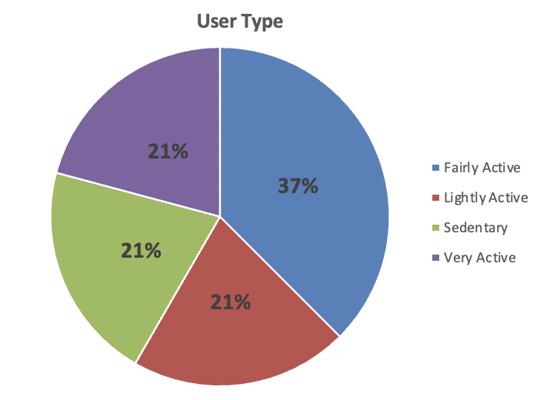
Classifying users based on number of steps
From this chart we can see that users are fairly distributed considering their number of steps. We can determine from this that all kinds of users wear smart devices.

Slide 13
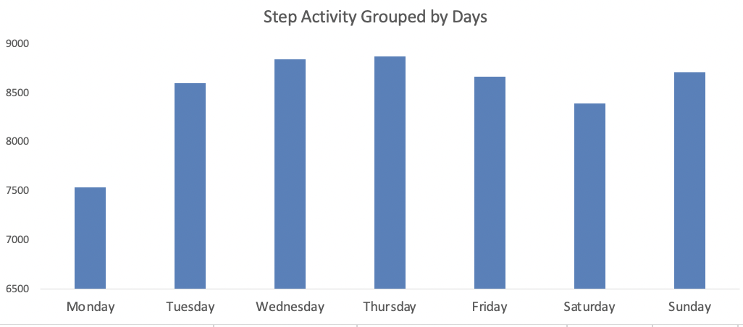
Investigating activity throughout the week(Steps taken)
From the tables and chart above we can determine that all users walk the recommended minimum number of steps (7500) daily.

Slide 14
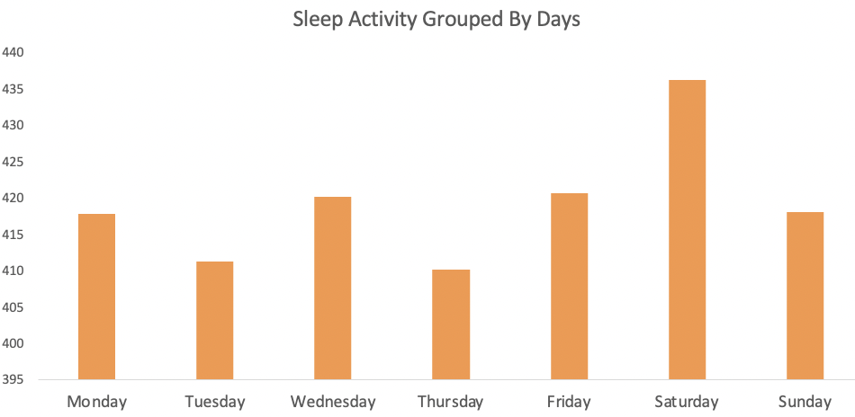
Investigating activity throughout the week(Sleep Activity)
The healthy minimum amount of sleep is 8hours which is 480minuites. The table and chart show that none of the users meet the minimum daily sleep requirement.

Slide 15
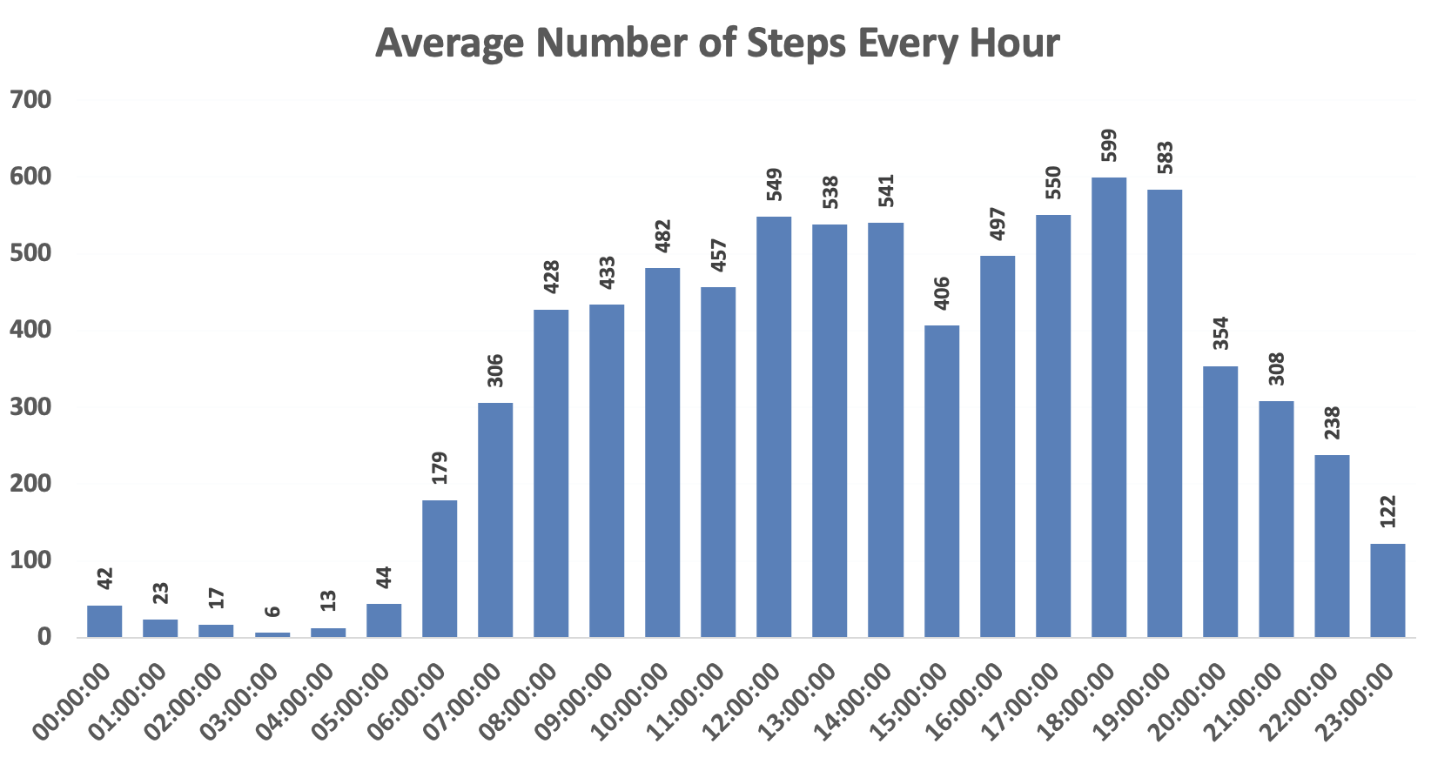
Hourly Steps
Most steps are from 12pm to 2pm and from 5pm to 7pm these time are usually lunch and supper times

Slide 16
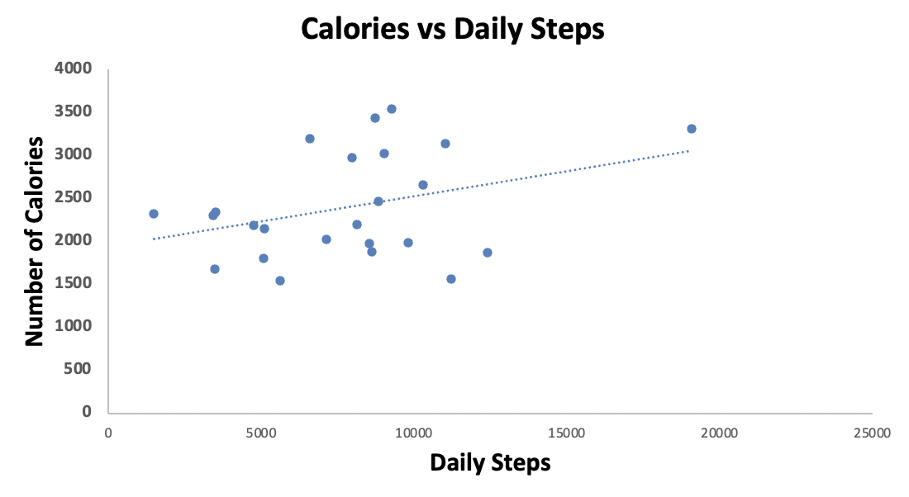
Correlation (Calories and Steps)
There is a correlation between calories and daily steps

Slide 17
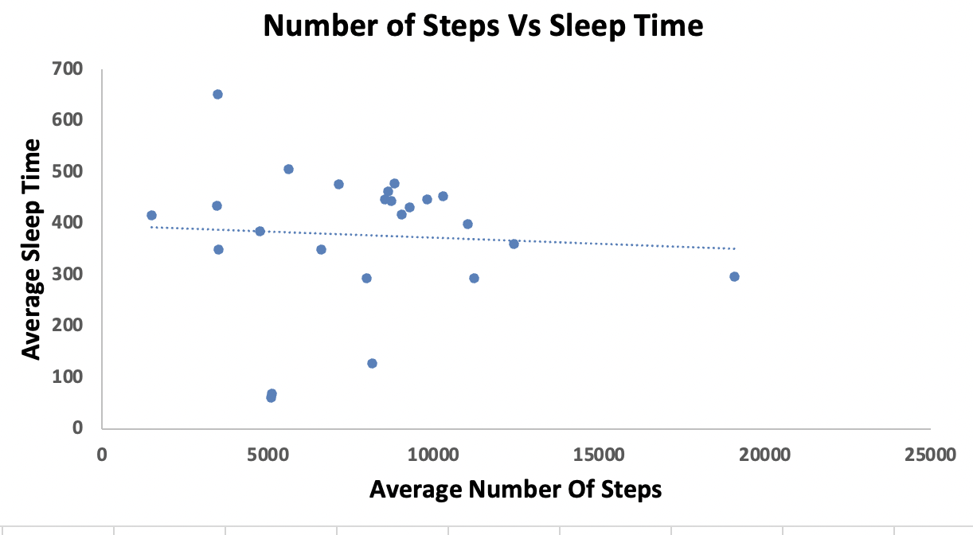
Correlation (Sleep Time and Steps)
There is no correlation between number of steps and minutes spent sleeping

Slide 18
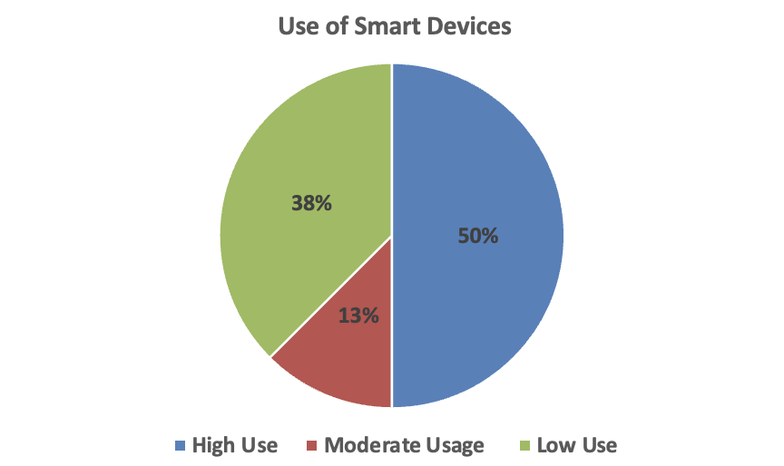
Usage of Device
50% use their device regularly (21-31 days)
12.5% use their device moderately(11-20days)
37.5% rarely use their device (0-10days)

Slide 19
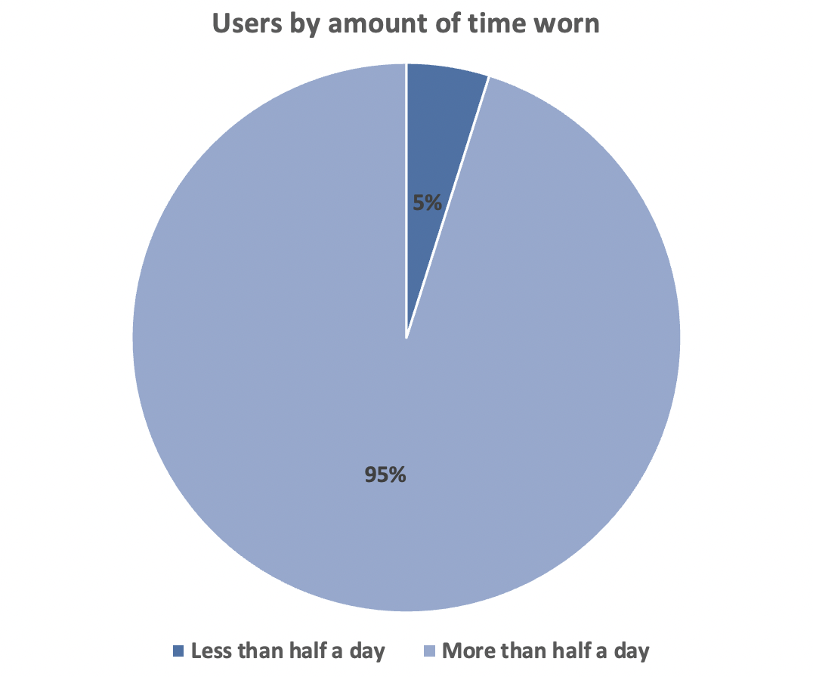
Amount of time the device is worn throughout the day
Most users wore the device for more than half a day.

Slide 20
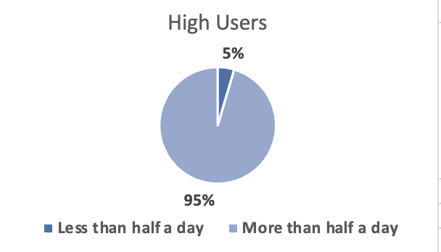
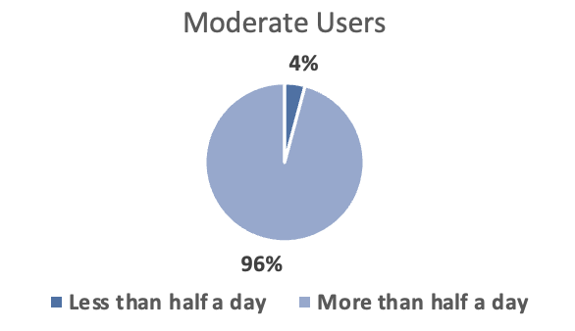
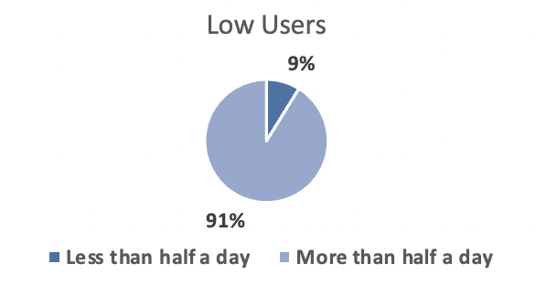
Amount of time worn by the usage of the device
This chart shows that 95% of people who used the device regularly wore them for more than half a day and 5% wore them for less than half a day
96% of Moderate users wore the device for more than a day and 4% wore the device for less than half a day
91% of users who rarely use the device wear it for more than half a day and 9% wear it for less than half a day

Slide 21
Recomendations

Slide 22
From the chart showing the usage of the device the highest percentage was from fairly active users 38% as compared to 21% from active users. Marketing campaigns can be organized to show the benefits of tracking your activities in order to increase the appeal to the active users.
Articles or blogs can be added to the Bellabeat app to educate users on benefits of living a healthy life and how being able to keep track of such data can help. This endeavor is aimed at reducing the percentage of low users of smart devices which is currently at 37.5%

Slide 23
Also, the Bellabeat app can be designed to set targets in terms of steps walked, water drank, etc. This will motivate users to meet the targets hence increasing activity and use of the device
From our analysis the needed sleep target of 480minutes (8 hours) wasn’t reached on any of the days. Bellabeat’s app can have an alarm that serves as a sleep reminder as well as wake users up. Users can set a particular time they have to wake up and the app will then calculate a recommended interval with alarm reminders for time to sleep and wake up.

Slide 24
From our analysis we found out that none of the users wore the device the all day even though a high percentage (95%) wore it for more than half a day. Suggestions to remedy this include:
A strong battery that can last the whole day
Fashionable devices that can be worn to events so that it can be on the user at all times
Water and dust resistant products for durability

Slide 25
Thank You

